Slide 1
Angular
Day 4

Slide 2
Objectives
Angular Core Concept
Services
Angular Components
Component Communication
Sending data from Parent to Child
Sending data from Child to Parent
Communicating with other component using services.

Slide 3
Angular Service
Let’s see one small demo for better understanding of service.

Slide 4
Angular Components
Component is piece of code which is generated for certain task. Components are reusable entity. We can create components for different functionalities like Login, signup , sign in, User Registration .
Example – As we know that in Web application all pages need header , footer so we will create component for Header, footer and can use in all pages.
There is a by default component present in Angular that is App component. App Component is called as root component of angular application
How to Create Components?
There are two ways to create components
Manually add files and write all code inside it. Like selector, decorator
Create component using cli

Slide 5
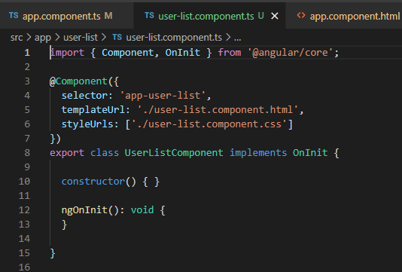
Angular Components
Which four files getting generated with component creation?
Component_name.component.css → for styling
Component_name.component.html → template where we can add HTML elements and this will be rendered on browser
Component_name.component.ts → logic or functionalities can be implemented in this file.
Component_name.component.spec.ts → For implementing testing code.
@Component is called as decorator, In which there is mentioned that selector. So if we want to access user-list.component.html then we have to add selector of this component to html page where we have to use user-list-comonent.html page

Slide 6
Angular Components
Now, will it work, if I will create new component in another module?
No, it won’t we will get error →'app-login' is not a known element:
How to Fix it ?
Step 1. The component which we will have to export that module need to add in export array of module file.

Slide 7
What is module?
Component1
Component2
Component3
Component4
Services
Pips
Directives
In Angular modules means collection of components, services, directives and pips which are related. We can consider example of user module in which there will be multiple components like sign in, sign up , registration etc.

Slide 8
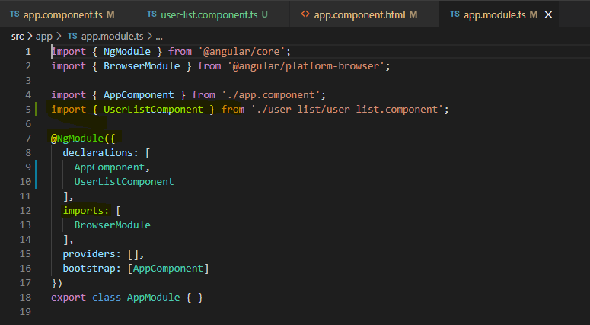
What is module?
The above picture is app.module.ts which is generated by default with project
Which included declaration – we need to declare the used module in it. Import- we need to mention name of module in which used. Provider we need to provide which components used.etc

Slide 9
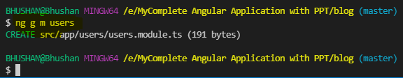
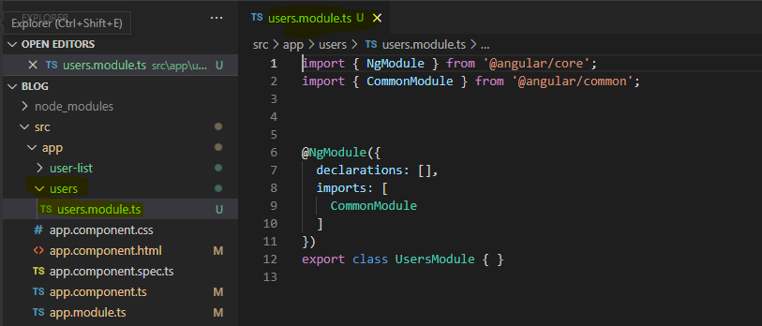
How to add/ create module
To create new module we need to fire a simple command.
ng g m users
Here users module has been added to our project-

Slide 10
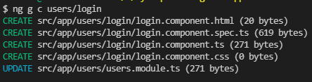
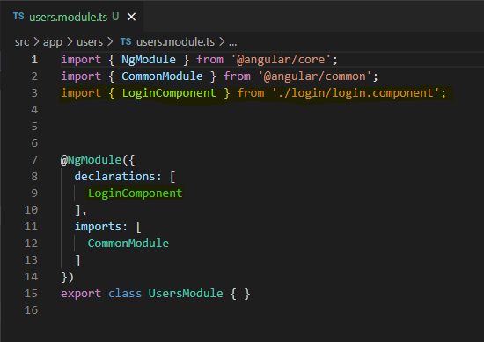
Add component in user module
If we will create component without mentioning module name then it will be added to app module. So we will have to mention the name of module if we want to create a component for specific module.
In this case we have to create a component in users module as login. For this we have to fire following command.
ng g c users/login
As soon as we add new component login to users module , it’s information will be added to users.module.ts

Slide 11
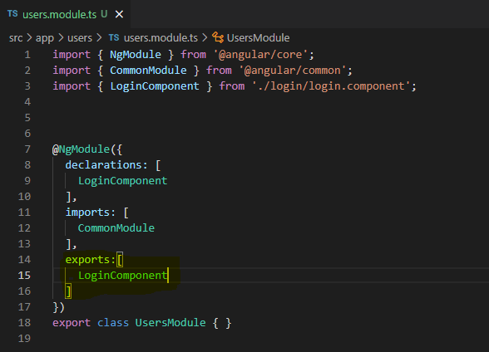
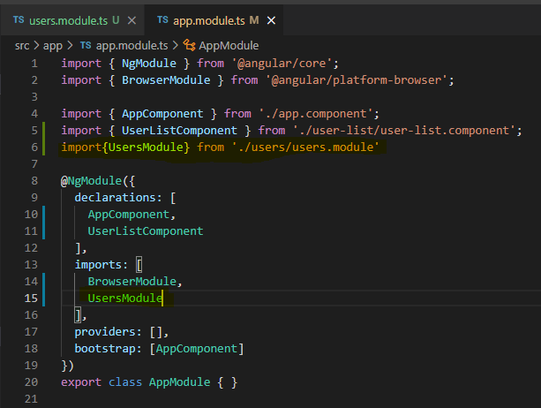
Export login component and import in app module
When we want to use this component in other module then we need to export this component to other module.
To use this module in app module we have
to import user module in app.module.ts

Slide 12
Export login component and import in app module
After exporting from users.module.ts and importing in app.module.ts , we can use content of users.component.html page into app.component.html page
Steps to remember
Create new module
Export specific component in module
Import the specific module
Use selector to call content of html page in our page.

